Slide 1
Impact Based Forecasting and Risk Based Warnings
Mark Bevan and Chris Tubbs
Session 2 - 01 November 2016

Slide 2
Group Exercise – effective warnings
Divide into two groups –
Emergency Managers
Forecasters
Discuss:
Who are the audience for weather warnings?
What do they need to know?
When do they need to know?
What methods should we use to tell them?
Be ready to present your teams thoughts back to the group as part of a discussion in 30 minutes.
Notes:
Divide into 3 to 4 groups (table rows?)
Why do we need warnings? How are they different to a normal forecast? Why is this important?
Who needs them? Public, responders, media. Are their needs the same? Key point through the next few days is who the warning is for and to make sure we fulfil their requirements. We will look at why this is important in the next session.

Slide 3
Why warnings?
Group Exercise
FEEDBACK
Notes:
Divide into 3 to 4 groups (table rows?)
Why do we need warnings? How are they different to a normal forecast? Why is this important?
Who needs them? Public, responders, media. Are their needs the same? Key point through the next few days is who the warning is for and to make sure we fulfil their requirements. We will look at why this is important in the next session.

Slide 4
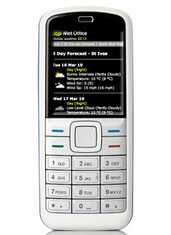
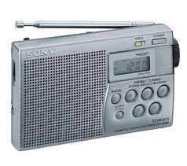
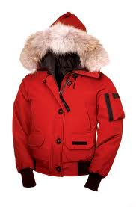
An effective warning
Easy to
understand
Help
Emergency
Responders
respond
Variety of
access points
Essential
Elements
Easy to
access
Help
Emergency
Responders
plan
Help people
decide
what to do
Change
behaviour
Effective
Notes:
A summary

Slide 5
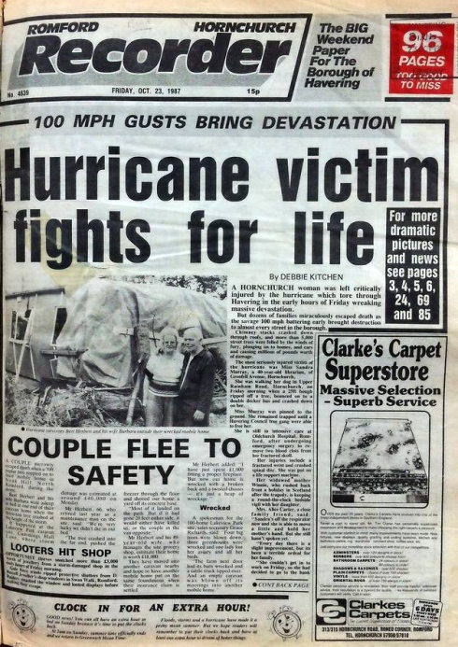
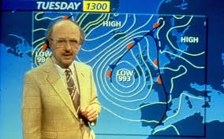
History of NSWWS
1987 - Michael Fish’s ‘Hurricane’ - 18 deaths, 15 million trees lost, hundreds of thousands of homes without power.
1988 - Government funded, meteorologically determined threshold based warning service begins

Slide 6
How we used to do it... 1988-2011
Severe gales/storms Heavy snow
Blizzards/drifting Heavy rain
Freezing rain/glazed frost/widespread icy roads Widespread Dense Fog
Early warnings
When the forecaster had confidence that there would be “disruption” due to severe weather in the next 5 days he would issue an Early Warning.
Flash warnings
When the forecaster had 80% or more confidence that there would be severe weather in the next few
hours (up to 24 hours) he/she would issue a flash warning. Flash warnings were based on specific weather thresholds being exceeded, for example severe gales when gusts reach 70mph or more over land areas
Emergency Flash Warnings
These were issued with up to 24 hours notice (but usually much less than this) when
extreme conditions were expected .
Motoring Unit Warnings (discontinued 2005)
There was a lower tier of warning – the Motoring Unit Warning – which had lower thresholds
and which were aimed specifically at motorists. These gave warnings of rain, heavy enough
to give spray and standing water, fog (visibility less than 200m), widespread ice, snow and
wind.

Slide 7
History of NSWWS
2009 – research undertaken into how to improve the warnings service:
12 public focus groups
7 responder workshops
Media meetings
‘Warning categories are too complex. Needs to be simplified’
‘Weather warnings should only be issued if severe weather is expected to have an impact’
2011 - Impact based NSWWS launched

Slide 8
5 Weather Elements
RAIN
ICE
WIND
FOG
SNOW

Slide 9
Impact and likelihood – 2011 onwards
Not just the nature of severe weather – no thresholds!
Impact based system
Two factors:
The level of impacts expected – dependent on:
Location
Timing
Recent weather
Likelihood of impacts occurring

Slide 10
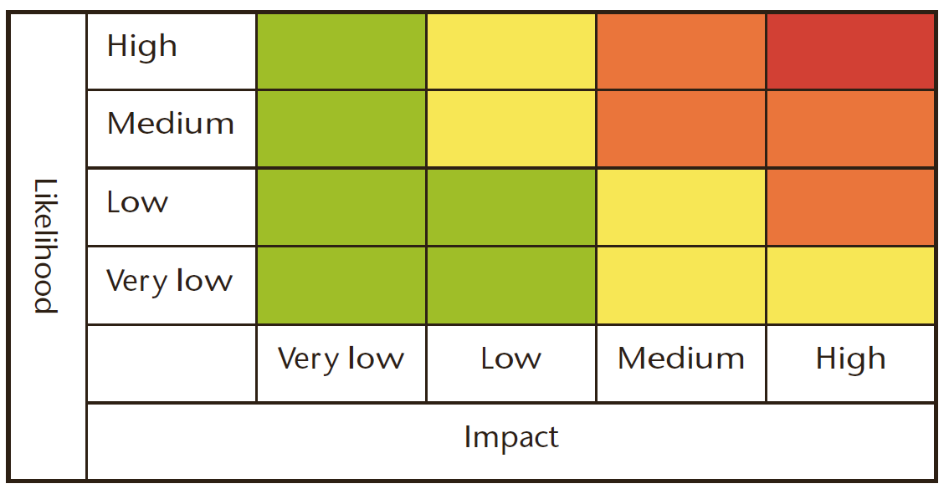
The Matrix Colour determined by the combination of the likelihood and impacts

Slide 11
Impact and likelihood
Impact
Time of day
Time of year
Antecedent conditions
Rural vs Urban
Non-weather factors
Likelihood
Forecast uncertainty
Most likely scenario
Reasonable worst case scenario

Slide 12
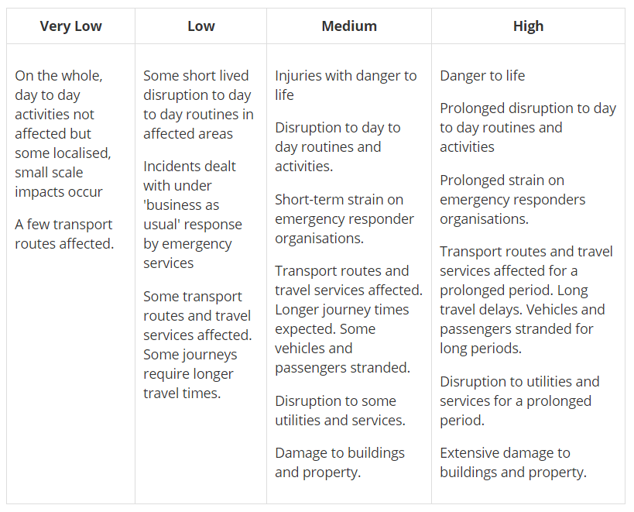
Impact tables – all weather types

Slide 13
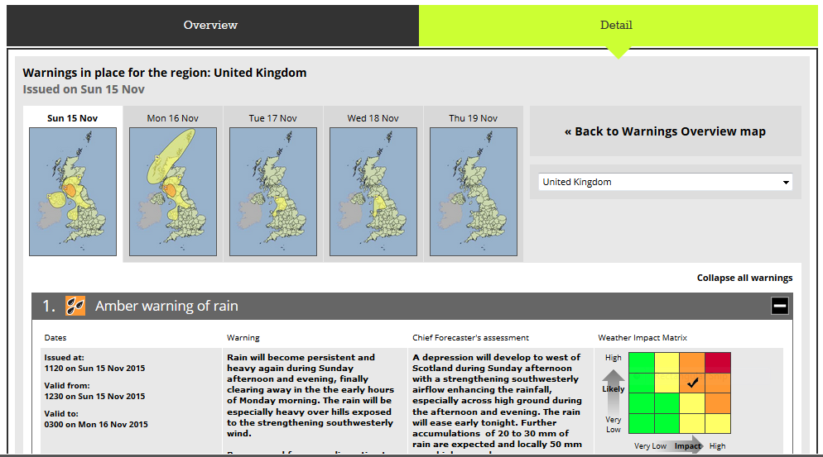
National Severe Weather Warning Service

Slide 14
Key points in communicating the warning
Clarity
Plain language
No technical jargon
Focus on what the user of the warning needs to know
Graphics, if possible
A picture tells a thousand words!
Needs to be accessible (see later in the week!)
What about uncertainty?

Slide 15
Communicating Uncertainty
Language
“There is a chance of a shower”
“Temperatures may rise as high as 35C”
“It should stay dry until after dark
Can appear to be vague
Can be understood differently by different people

Slide 16
Communicating Uncertainty
Probability
“There is an 80% chance of a shower”
“There is an 20% chance of a shower”
“There is a 60% chance of rain in the morning but only 30% chance in the afternoon.
Seems more scientific, but is it?
Do people fully understand probabilities

Slide 17
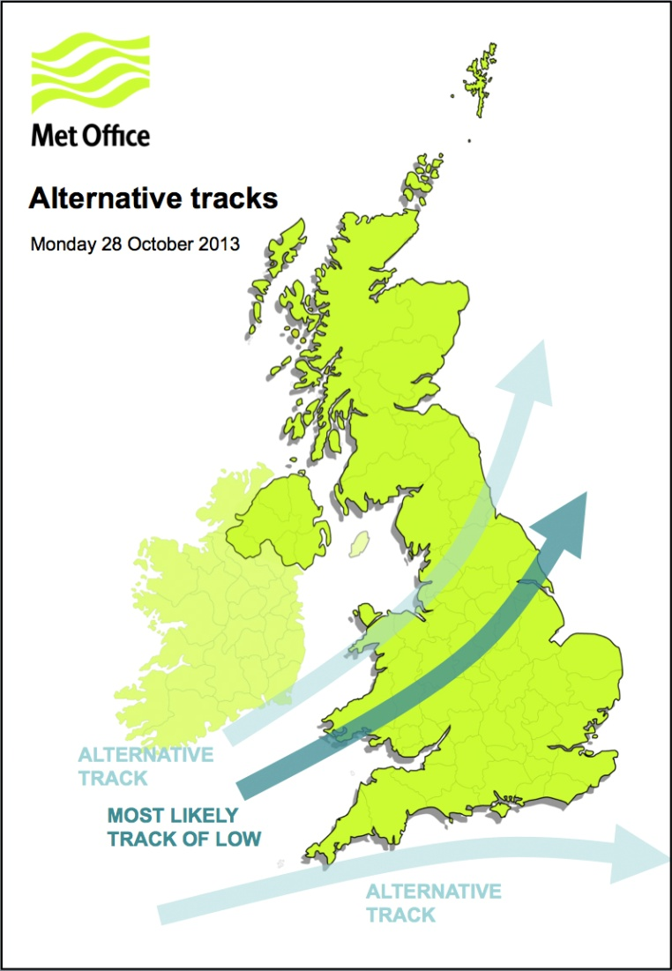
Communicating Uncertainty - using graphics
Notes:
At longer range, good for explaining what might happen as an alternative

Slide 18
Summary
Developing warnings
Warnings are needed to help protect lives and infrastructure
Find out what the user needs to know, and provide it!
Effective warnings change behaviours
Communicating warnings
Clarity – plain language
Timeliness!
Don’t be frightened of expressing uncertainty. That can help users make decisions.

